Slide 1
ACS Mid-Atlantic Regional Meeting Combined Heat and Power in Automobiles: Utilization of Waste Engine Heat to Drive Ethanol/Water Distillation
Benjamin D’Alessio, John Allen Rudesill and Douglas Frey
University of Maryland Baltimore County
Department of Chemical, Biochemical and Environmental Engineering
June 2, 2012

Slide 2
Outline
Project background
Project proposal
Design and components
Results and system evaluation
Practical considerations

Slide 3
Project Background
Why do we care about using ethanol as an alternative fuel?

Slide 4
Project Background: Why use ethanol?
Environmental standpoint
Ethanol is a clean-burning fuel that produces less greenhouse gas emissions than gasoline^{[1]}
Energy independence standpoint
Ethanol is currently used as a fuel additive and octane booster; has the potential to reduce the need for fossil fuels from foreign sources significantly^{[2]}
This fuel can be produced from corn and cellulosic sources grown here in the United States
[1] Wang et al. Effects of Fuel Ethanol Use on Fuel-Cycle Energy and Greenhouse Gas Emissions. U.S. DOE. 1999.
[2] Shapouri H. et al. The Energy Balance of Corn Ethanol: An Update. 2002.
Notes:
citation

Slide 5
Project Background: Ethanol Production
Six basic steps in manufacturing ethanol^{[1]}
Milling of corn
Liquification
Saccharification
Fermentation
Distillation
Dehydration
[1] Kwiatkowski, J.R. et al. Modeling the process and costs of fuel ethanol production by the corn dry-grind process. 2005

Slide 6
Project Background: Ethanol Production
Six basic steps in manufacturing ethanol^{[1]}
Milling of corn
Liquification
Saccharification
Fermentation
Distillation
Dehydration
Most energy intensive steps
[1] Kwiatkowski, J.R. et al. Modeling the process and costs of fuel ethanol production by the corn dry-grind process. 2005

Slide 7
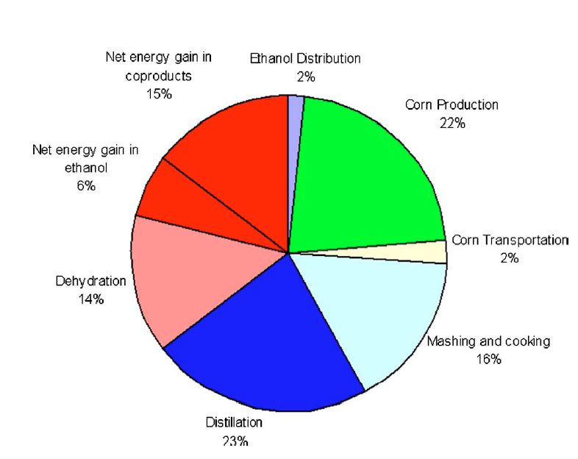
Project Background: Ethanol Production
[1]
[3] Martinez-Frias et al. Improving Ethanol Life Cycle Energy Efficiency by Direct Utilization of Wet EtOH in HCCI engines. 2007

Slide 8
Project Background: Improving Net Energy Value
Use of wet ethanol in traditional internal combustion engines
Modify fuel tank, fuel lines and carburetor to accommodate ethanol/water fuel^{[1]}
Pre-vaporization often necessary
Mixtures of 90% EtOH and below have been tested
Homogeneous Charge Compression (HCCI) engines^{[2,3]}
Use ‘wet ethanol’ in concentrations as low as 35% EtOH by volume as fuel source
Potential to decrease distillation requirement by 20% and complete elimination of dehydration step
Not suitable yet for use in transportation vehicles
[1] Williams J. Steady-State dynamometer Testing of a Passenger Van: Comparing Operation on Gasoline and Aqueous Ethanol. 2004.
[2] Martinez- Frias, J. et al. Improving Ethanol Life Cycle Energy Efficiency by Direct Utilization of Wet Ethanol in HCCI Engines. 2007.
[3] Mack, J. et al. Direct Use of Wet Ethanol in a HCCI Engine: Experimental and Numerical Results. 2007.

Slide 9
Project Proposal
What else can be done to increase the net energy value of ethanol as an automotive fuel?
9
Notes:
9

Slide 10
Project Proposal: Utilize waste engine heat
Internal combustion engines have very low efficiency
Between 60% and 80% of energy is dissipated as heat through the engine block or exits the tailpipe
Close to 15% of mechanical energy reaches the wheels^{[1]}
If ethanol is used as a primary fuel, its combustion energy can be used to do not only mechanical work but can also provide heat energy from combustion to drive its own distillation
This would allow lower purity ethanol to be produced at the production scale, thus limiting the distillation requirement and eliminating the need for dehydration
GOAL: Build a proof of concept and evaluate feasibility of implementation from an energetic and mechanical standpoint
[1] U.S. DOE. Advanced Technologies and Energy Efficiency. http://www.fueleconomy.gov/feg/atv.shtml.

Slide 11
Energy Balance for 50% EtOH Production

Slide 12
Engine and column schematic
Gasoline Startup
90 % v/v EtOH
Engine
50 % v/v EtOH
Heat Energy
Bottoms
Exhaust

Slide 13
Start up mode
Gasoline Startup
90 % v/v EtOH
Engine
50 % v/v EtOH
Heat Energy
Bottoms
Exhaust

Slide 14
Transfer to ethanol fuel
Gasoline Startup
90 % v/v EtOH
Engine
50 % v/v EtOH
Heat Energy
Bottoms
Exhaust

Slide 15
Design and Components

Slide 16
Overall Design Strategy of System
Distillation Column
Heat Exchanger
Engine
Load
Efficiency
Fuel consumption rate
Lower heating value of gasoline
EtOH equivalent rate
Desired distillate flow rate
Distillate flow rate
Feed composition/flow rate
Diameter/Height
Packing material
Reboiler and condenser duties
Heat energy needed
Heat energy available
Best method of transfer

Slide 17
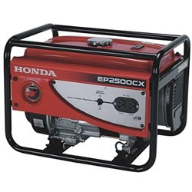
Engine Specifications
Displacement: 160 cc
Max Power Output: 2.5 kWh
Fuel Capacity: 3.9 gallons
Reasons for choosing generator set
Runs at constant load delivering relatively constant exhaust temperature once steady state is reached
Can vary based on load, and a range of loads was used during experimentation
Muffler and components can easily be removed to accommodate longer exhaust piping for heat exchanger

Slide 18
Determining Fuel Intake and Energy Output
Specification | Value
Load | 2.0 | kWh
Efficiency | 20 | %
Fuel capacity | 3.9 | gallons
Energy Used (same as load) | 6,824 | BTU/hr
Energy Needed (assuming 20% efficiency) | 34,120 | BTU/hr
Lower Heating Value | 116,090 | BTU/gal
Gasoline Consumption rate | 0.29 | gal/hr
EtOH Lower Heating Value | 76,330 | BTU/gal
Equivalent EtOH Consumption rate | 0.45 | gal/hr
Desired EtOH distillate rate | 0.50 | gal/hr

Slide 19
Distillation Column Specifications
Continuous distillation column material balance first calculated using Excel
Final design based on ChemSep model
Column Specifications (based on 50% v/v ethanol feed)
Packed Column using stainless steel scrubbing pads as packing
Temperature monitored using thermocouples
Height: 10 feet
Diameter: 1.5 inches
HTEP: 13 centimeters
Distillate
Feed
Bottoms

Slide 20
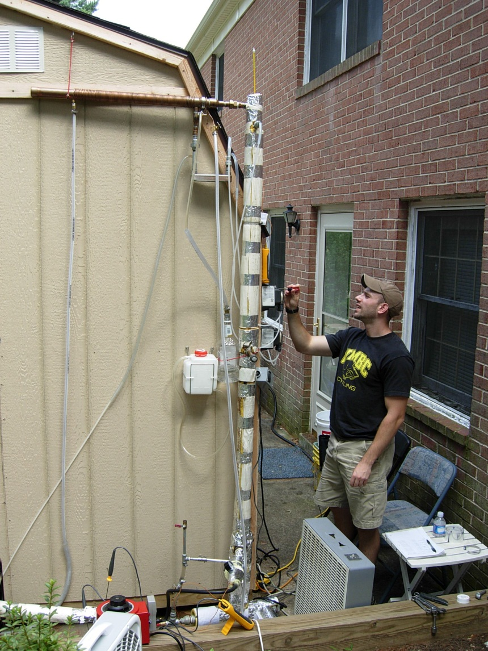
Distillation Column Fabrication
20

Slide 21
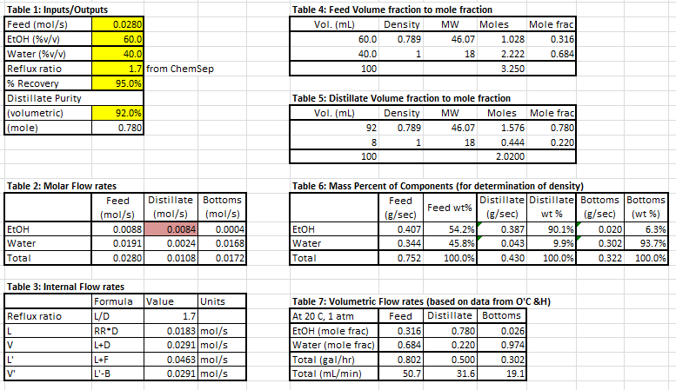
Distillation Column Material Balance: Excel

Slide 22
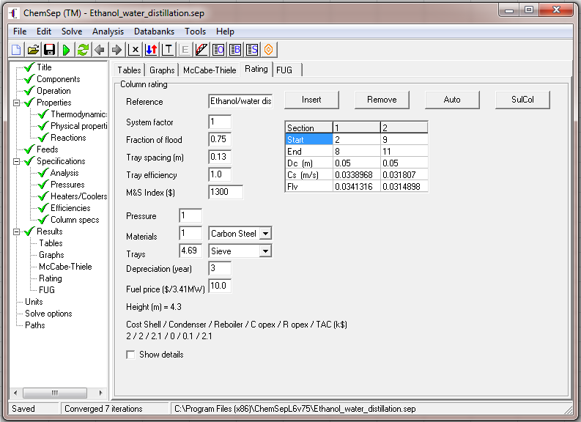
Distillation Column: ChemSep Specifications
 | Feed | Top | Bottom
Stage | 9 | 1 | 12
Pressure (N/m2) | 101325 | 101325 | 101325
Temperature (K) | 300 | 350.9 | 366.0
Mole flows (kmol/s)
Ethanol | 8.84E-06 | 8.40E-06 | 4.42E-07
Water | 1.91E-05 | 2.37E-06 | 1.68E-05
Total molar flow | 2.80E-05 | 1.08E-05 | 1.72E-05
Mole fractions
Ethanol | 0.316 | 0.780 | 0.026
Water | 0.684 | 0.220 | 0.974

Slide 23
Heat Exchanger Design Strategy

Slide 24
Heat Exchanger Design Strategy
Gasoline Startup
2. How much energy can be delivered from heat of combustion?
90 % v/v EtOH
3. What is the best method of transfer and regulation?
Engine
50 % v/v EtOH
1. How much energy is required?
Bottoms
Exhaust

Slide 25
How much heat is required?
Distillation column specifications
Feed: 50% EtOH
50% Water
Temperature: 300 K
Pressure: 1 atm
Distillate Flow rate: 0.50 gal/hr at 350 K
90 % v/v EtOH
50 % v/v EtOH
Reboiler duty: 6,950 BTU/hr
Bottoms

Slide 26
How much energy can be delivered?
Gasoline
For Honda EP2500CX
Assume : 20% efficiency
For gasoline, LHV: 116,090 BTU/gal
Available heat energy: 92,870 BTU/gal
Gasoline consumption rate: 0.30 gal/hr
Heat dissipation rate: 27,860 BTU/hr
60 to 80% dissipated heat
Engine
20 to 40 % mechanical and
electrical work

Slide 27
How much energy can be delivered?
Gasoline
For Honda EP2500CX
Assume : 20% efficiency
For gasoline, LHV: 116,090 BTU/gal
Available heat energy: 92,870 BTU/gal
Gasoline consumption rate: 0.30 gal/hr
Heat dissipation rate: 27,860 BTU/hr
60 to 80% dissipated heat
Engine
20 to 40 % mechanical and
electrical work

Slide 28
How much energy can be delivered?
Gasoline
For Honda EP2500CX
Assume : 20% efficiency
For gasoline, LHV: 116,090 BTU/gal
Available heat energy: 92,870 BTU/gal
Gasoline consumption rate: 0.30 gal/hr
Heat dissipation rate: 27,860 BTU/hr
60 to 80% dissipated heat
Engine
20 to 40 % mechanical and
electrical work
Heat available to drive distillation almost 4x what is required
Heat Duty: 6,950 BTU/hr

Slide 29
How much energy can be delivered?
Ethanol
For Honda EP2500CX
Assume : 20% efficiency
For ethanol, LHV: 76,330 BTU/gal
Available heat energy: 61,060 BTU/gal
Ethanol consumption rate: 0.45 gal/hr
Heat dissipation rate: 27,500 BTU/hr
60 to 80% dissipated heat
Engine
20 to 40 % mechanical and
electrical work

Slide 30
How much energy can be delivered?
Ethanol
For Honda EP2500CX
Assume : 20% efficiency
For ethanol, LHV: 76,330 BTU/gal
Available heat energy: 61,060 BTU/gal
Gasoline consumption rate: 0.45 gal/hr
Heat dissipation rate: 27,500 BTU/hr
60 to 80% dissipated heat
Engine
20 to 40 % mechanical and
electrical work
Similar heat transfer rate as gasoline because fuel consumption was adjusted. Will probably be slightly lower since about 90% aqueous EtOH will
eventually be used.

Slide 31
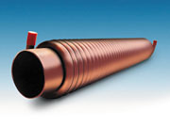
Methods of heat transfer and regulation
Direct Heating
Copper tubing wrapped around exhaust pipe, reboiler contents recirculated through coiled tubing
Pros: More efficient transfer of heat from exhaust gas to reboiler stream
Cons: Control of heat not as easy, requires the need to pump high temperature water that could vaporize
Use of a heat exchange medium
Ethylene glycol recirculated through coiled tubing
Pros: Better control through regulating circulation rate, normal boiling point 197°C.
Cons: Less efficient as there will be inherent heat losses in pumping and transfer to reboiler
[1]
[1] GFX Heat Exchanger. Retrived from http://www.achrnews.com/Articles/Feature_Article/392ce1c95795a010VgnVCM100000f932a8c0

Slide 32
Design methods

Slide 33
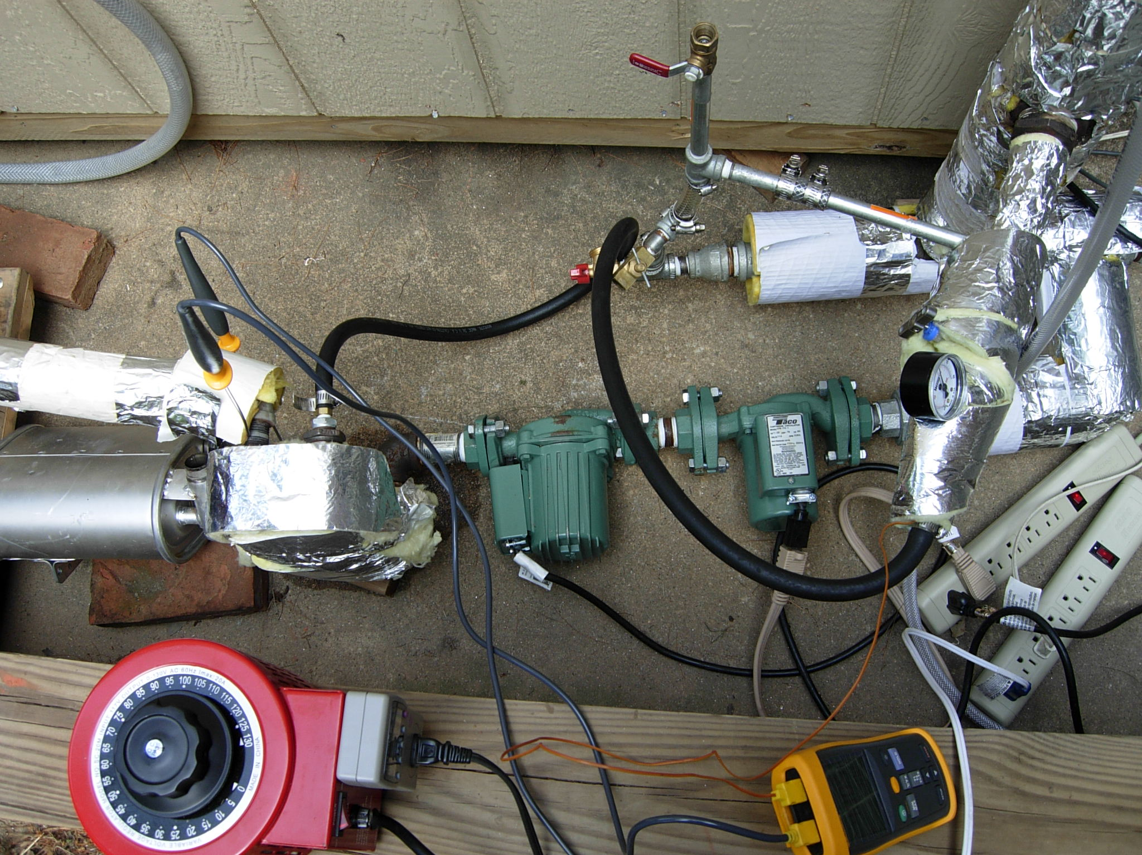
Exhaust Heat Integration
33

Slide 34
Final Design Specifications
Distillate purity of 90 % v/v
Distillate flow rate of 0.50 gal/hour
Effective Heat Capture using plate and frame heat exchanger
34

Slide 35
System Evaluation
What really matters?

Slide 36
Phase I: Distillation Column Fabrication
Column Height reduced to about 10 feet overall, with about 7 feet of packing
Heat supplied initially using a 1500W heating element
Initial testing showed too much heat was present, despite reboiler duty of ∼2040W
Used a Variac to reduce heat input
Reboiler design likely affected how heat was distributed to reboiler contents – probable vapor pocket formation that resulted in flooding

Slide 37
Phase I: Distillation Column Fabrication
Continuous distillation proved to be too difficult to control – erratic purity and distillate flow rate
Required finding optimal feed flow rate, reflux return rate and heat input that didn’t produce flooding
Continuous column was converted to batch column
Provided much more consistent results with heating element
Control of top temperature mainly achieved by adjusting heat input to reboiler
Although heat input did impact distillate flow rate, this was mainly controlled by reflux return rate
Overall distillate flow rate and purity determined at end of run

Slide 38
Phase II: Exhaust Heat Integration
Initially created a mock setup to recirculate water through heat exchanger connected to engine exhaust outlet and vaporize to determine if enough heat was present
Used two centrifugal pumps connected in series
Discovered temperature drop across muffler was nearly 200°C; muffler was removed and exchanger was connected directly to engine cylinder outlet
Modification provided necessary heat to create desired vapor flow rate
Coupled distillation column to heat exchanger

Slide 39
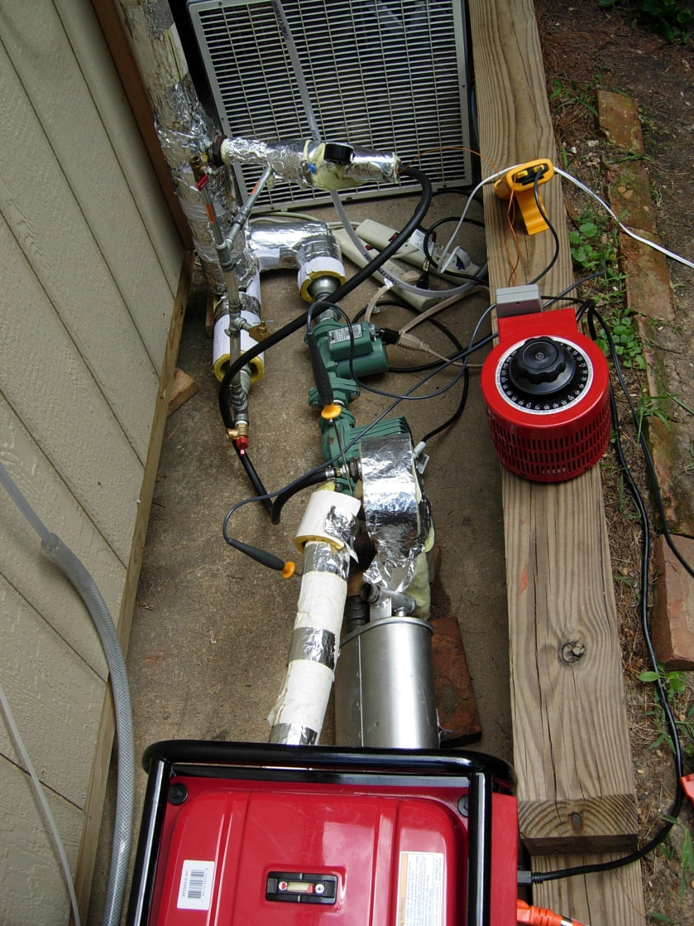
Phase II: Exhaust Heat Integration

Slide 40
Phase III: Modify engine to run on 90% EtOH
Couple distillation column to exhaust heat using final design of heat exchanger
Perform several runs evaluating whether enough heat is present based on exchanger calculations and flow rates of exhaust and heat exchange medium
Based on attainable outputs of distillate, overall feasibility of implementing the apparatus will be evaluated

Slide 41
Evaluating the system: What really matters?

Slide 42
Consider the following…
How well does the system in its current setup work? What are the determining factors of success?
Distillate purity and flow rate
Ease of control
How do the expected results compare with the actual results?
What are the implications of any discrepancies?
What factors affect the performance of the column?
Heat input
Reflux ratio
Overall layout of column
Prevailing ambient conditions

Slide 43
Noted trends in column performance
Heat input that is too high leads to instability
Column flooding and compromised distillate purity
Continuous distillation mode too difficult to control – transfer to batch mode proved to be more stable
Heat input must be increased for consistent distillation to occur in the batch mode
Too high reflux return also produces flooding
Average engine loads on the lower end results in high purity; too low and not enough vapor is produced however

Slide 44
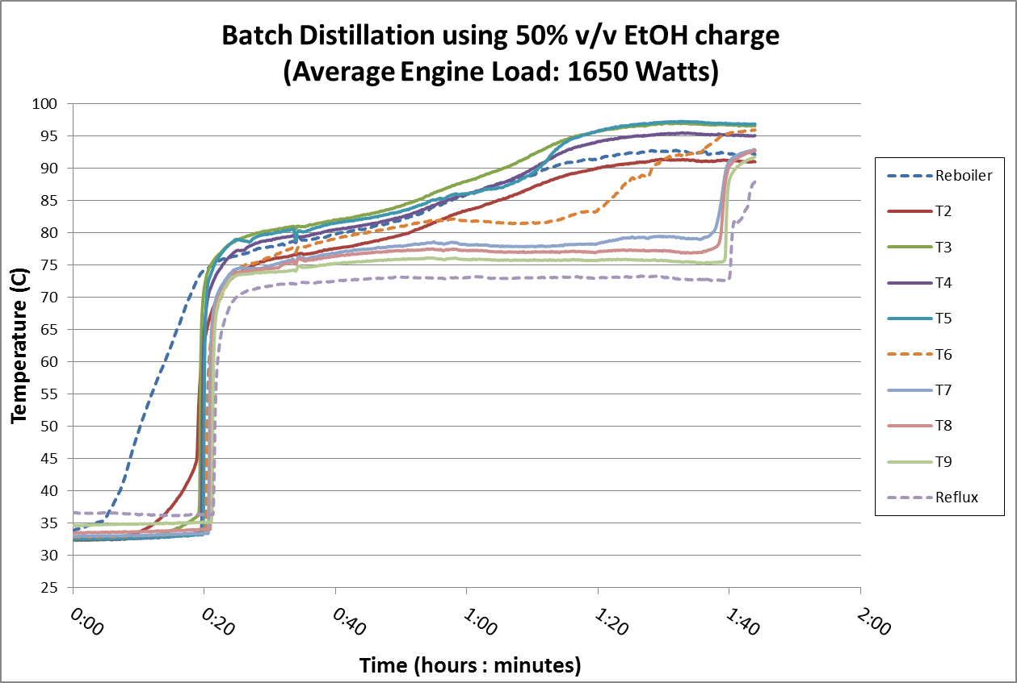
Effect of high heat input

Slide 45
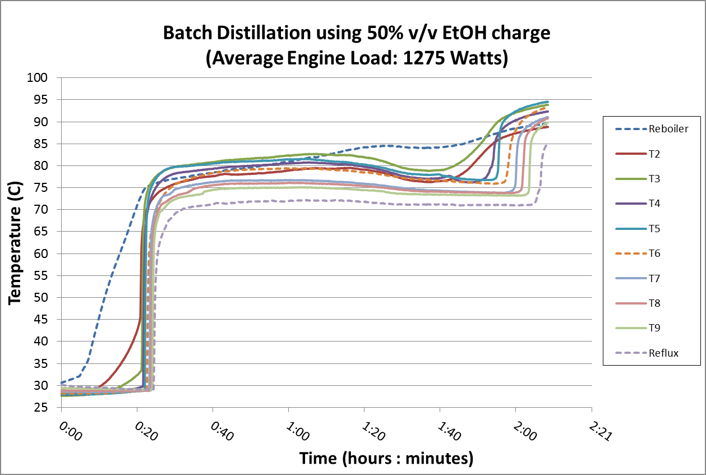
Effect of low heat input

Slide 46
Optimal purity attained at engine loads ~1200W

Slide 47
Distillate Flow Rate 15-20 mL/min

Slide 48
Integrated Heat Exchanger Temperature Profile
Exhaust Inlet
To Reboiler
Exhaust Outlet
From
Reboiler

Slide 49
Final Results: Were design goals met?
Distillate purity of 90 % v/v
Distillate flow rate of 0.50 gal/hour
Column was able to consistently produce 90 % or greater purity at 0.24 – 0.32 gal/hr
Even at lower loads, distillate flow rate could not match or exceed equivalent ethanol consumption rate
Larger column needed to provide necessary flow rate
Effective Heat Capture
Use of plate and frame heat exchanger provided adequate heat exchange
Likely not all of heat exchanger area was utilized
Recirculation of reboiler contents allowed for flashing to occur, precise control needs further development

Slide 50
Practical Considerations
Is it feasible?

Slide 51
Yes, but with some considerations…
Scale-up of column
Column height restrictions
Control of heat
Inertial forces on column and the effect on performance and efficiency
Weight: Need nearly twice the volume of fluids
Tankage for gasoline and reserve ethanol
Revamp of fuel delivery infrastructure
Short trip dilemma

Slide 52
Acknowledgements
ACS
John Rudesill
Dr. Frey
Dr. Castellanos
Dr. Kostov
Dr. Bayles
Robert Henderson

Slide 53
Questions?

